Slide 1

Capstone Project
Appliances Energy Prediction
By Umesh, Ifraz, Shailendra, Akram

Slide 2






Project Outline
1
Problem Statement
2
Data Summary
3
Exploratory Data Analysis
Topics For
Discussion
4
Feature Engineering
5
Model Selection & Training
6
Model Evaluation & Cross - Validation

Slide 3



Problem Statement
Objective of Project
The goal is to predict energy consumption by appliances.
Develop the perceiving of various parameters affecting energy consumption.
In the age of smart homes, the ability to predict energy consumption will not only save the money of end-user but also can contribute to energy conservation motive.

Slide 4

Data Summary
01
The dataset we have is a series of sensor data collected from a building in Belgium at an interval of 10 mins for a period of about 4.5 months.
The sensor data consists of temperature and humidity levels in different rooms in the building.
02
Among other features are weather reports on Pressure, Wind speed, Visibility, and T-dew point, which are recorded at weather station Chievres Airport, Belgium.
03
The target variable is the total energy consumption of the building in Wh.
The dataset has no null values.
04
Notes:
© Copyright Showeet.com – Creative & Free PowerPoint Templates

Slide 5
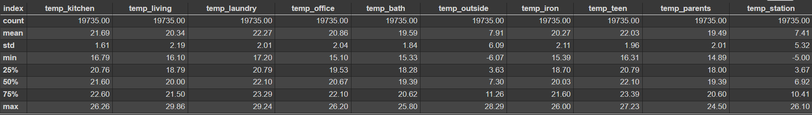
Descriptive Statistical Analysis (Temperatures)
Fig 1: Temperature DataFrame
The average outside temperature over a period of 4.5 months is around 7.5 degrees. It ranges from -6 - 28 degrees.
While the average temperature inside the building has been around 20 degrees for all the rooms.
This implies Warming appliances have been used to keep the insides of the building warm.
01
02
03

Slide 6
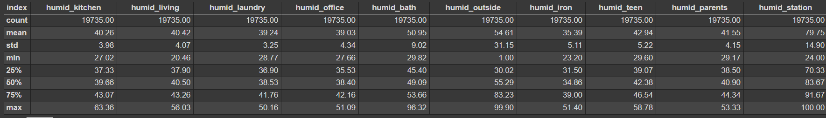
Descriptive Statistical Analysis(Humidity)
Fig 2: Humidity DataFrame
Average humidity at the weather station is significantly higher compared to outside humidity near the building
Kids and parent rooms show a comparatively higher average humidity as well signifying the fact that inhabitants of this building spend most of their time in these buildings.
Average humidity in the bathroom is significantly higher compared to other rooms due to obvious reasons.
01
02
03

Slide 7

Exploratory Data Analysis

Slide 8
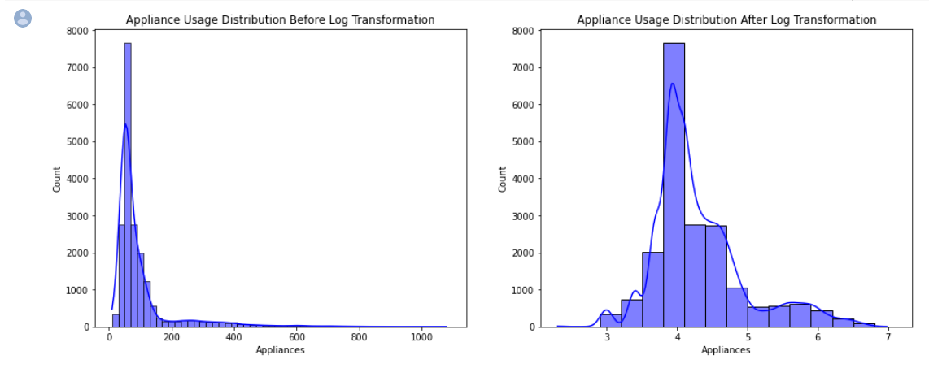
Target Variable
Energy consumption of appliances ranges from 10 Wh to 1080 Wh.
About 75 % of energy values lie below 100 Wh, and about 93 % of them lie below 300 Wh.
Our target variable seems to be highly skewed, and our task is to predict the usual as well as the large surges in energy in the building.
01
02
03
Fig 3: Target Variable Distribution

Slide 9
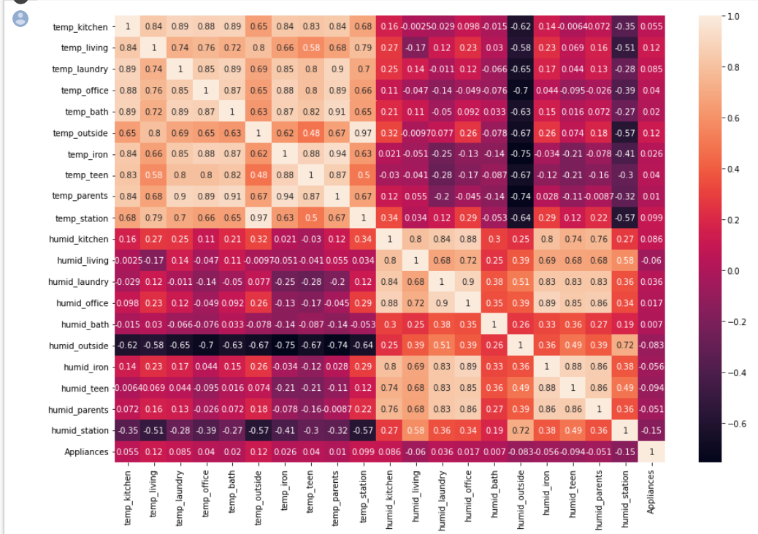
Pearson’s Correlation Matrix
The Temperature and humidity levels in each of the rooms are highly correlated among themselves.
There seems to be no relationship between humidity and temperature levels in the building. However, temperature and humidity levels outside the building are strongly negatively correlated.
There is little to no correlation between these features and the target variable i.e., Appliance energy consumption variable.
01
02
03
Fig :Heatmap Correlation Plot

Slide 10

Feature Engineering

Slide 11
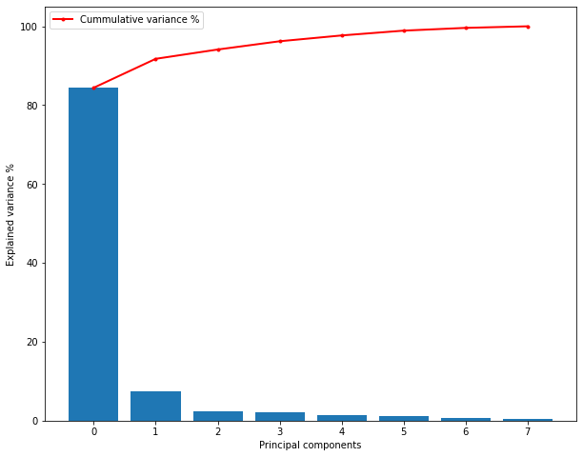
Principal component Analysis
Given, temperature levels in different rooms had a very low correlation with the target variable, and high correlation among themselves, we reduce the feature set into lower dimensions that could explain maximum variance.
PCA 1 and 2 explain more than 91 % variance in the temperature levels in different rooms in the building.
01
02
Fig : PCA on Temperature Features

Slide 12
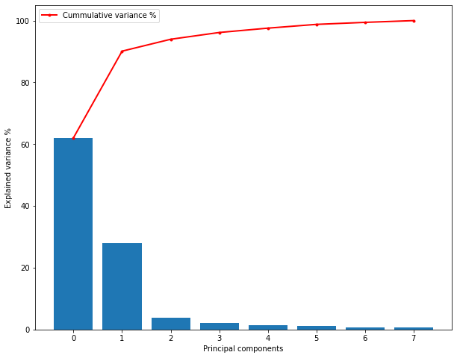
Principal Component Analysis
Given, humidity levels in different rooms had a very low correlation with the target variable, and high correlation among themselves, we reduce the feature set into lower dimensions that could explain maximum variance.
PCA 1 and 2 explain more than 91 % variance in the humidity levels in different rooms in the building.
01
02
Fig: PCA Humidity Features

Slide 13
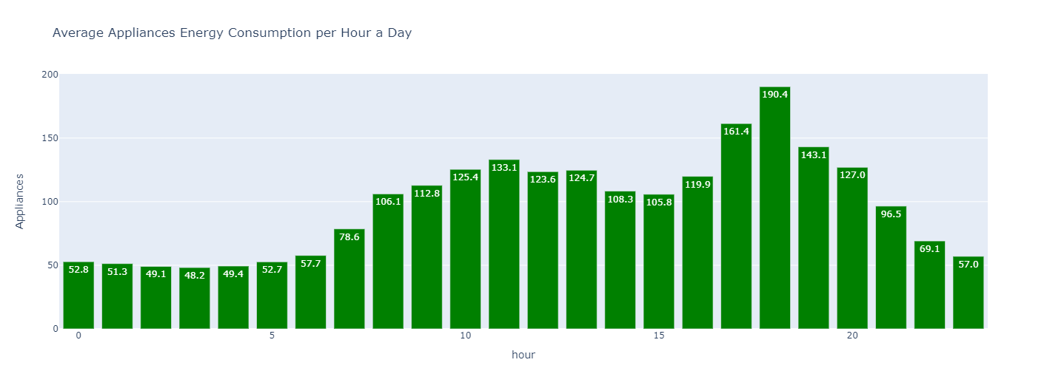
Date time (Hour)
We have a column called date which includes the timestamp corresponding to each of the sensor data samples.
There seems to be a pattern to the energy consumption of appliances at different times of the day.
01
02
Fig: Average Energy Consumption Per Hour of a day

Slide 14
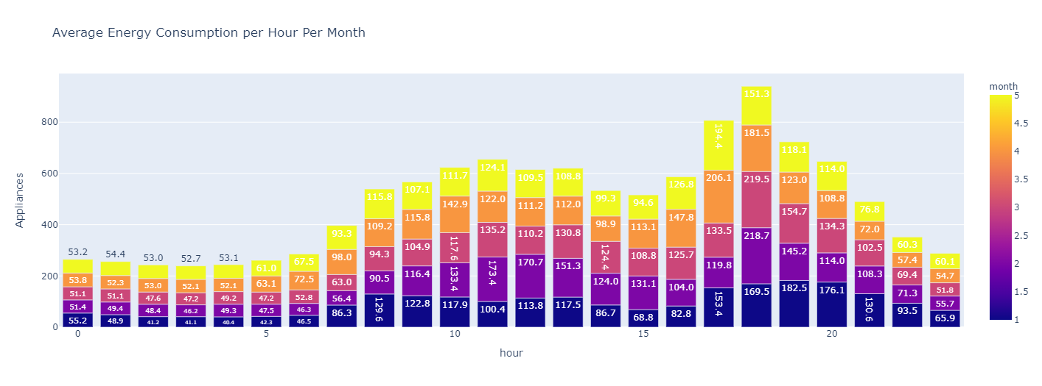
Date time (Month)
Fig: Average Energy Consumption Per Hour Per Month (for 4.5 Months)

Slide 15
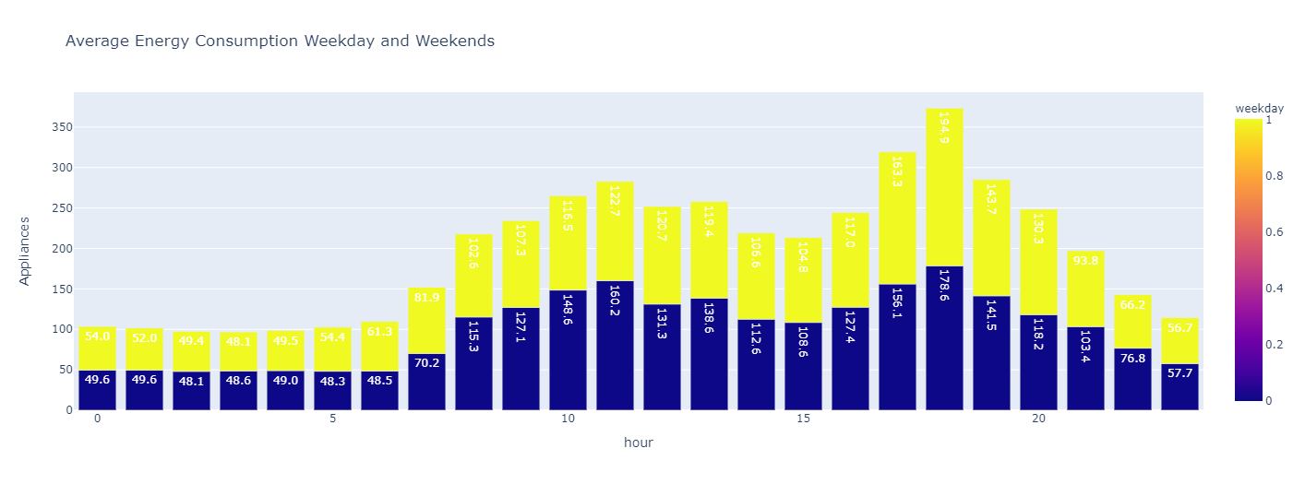
Date time (Weekday)
Fig: Weekday and Weekend Appliances Energy Consumption Comparison

Slide 16
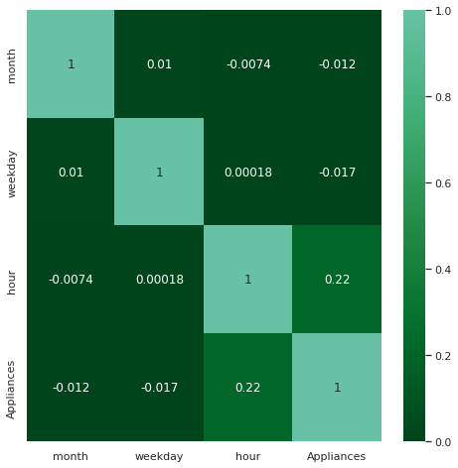
Correlation ( Newly Created Features)
There is no significant correlation between month and the appliance energy consumption, as we saw the pattern of consumption was almost similar overall months. The same is the case for weekdays and weekends.
However, there is a significant correlation between hours and the target variable.
01
02
Fig: Heatmap Correlation Plot

Slide 17
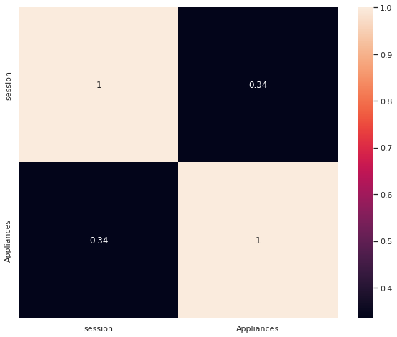
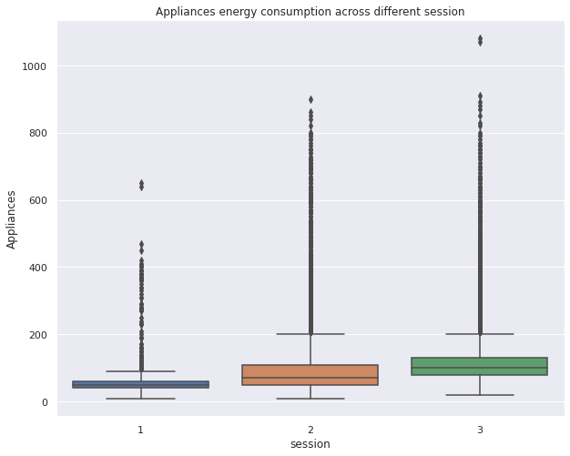
Session
We divided the dataset into 3 sessions :
Class 1: 10 PM - 6 AM
Class 2: 6 AM - 3 PM
Class 3: 3 PM - 10 PM
Fig: Heatmap Correlation Plot
Fig: Appliances Usages for each Session

Slide 18
Final Features
Feature Set I (With PCA) | Feature Set II (Without PCA)
Session | Session
Temperature - pca 1 | Temperature of all rooms inside building
Temperature - pca 2 | Humidity of all rooms inside building
Humidity - pca 1 | Temperature outside
Humidity - pca 2 | Humidity outside
Temperature outside | Pressure
Humidity outside | Wind speed
Wind speed
Table: Final Feature for Modeling

Slide 19



Model Training and Evaluation

Slide 20
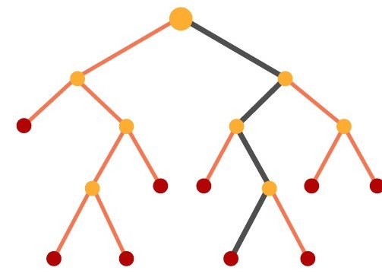
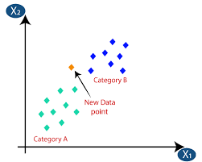
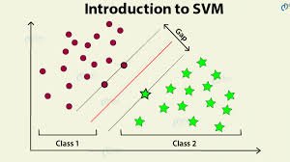
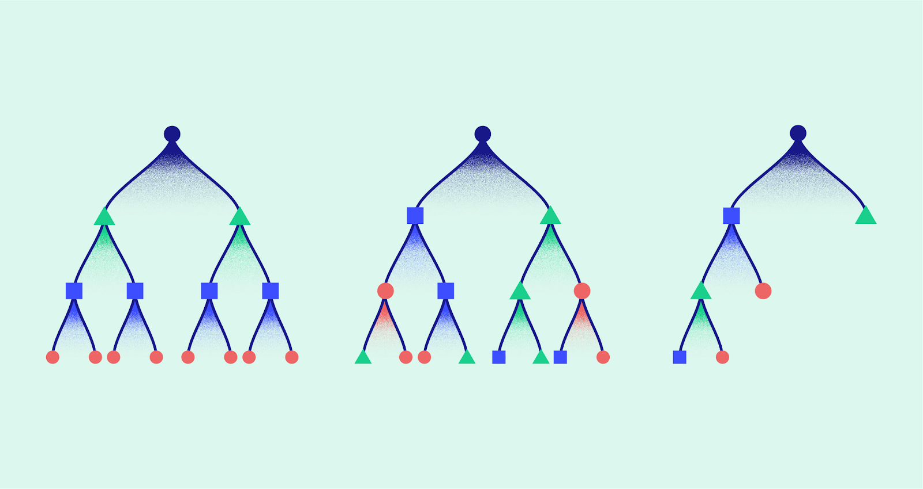
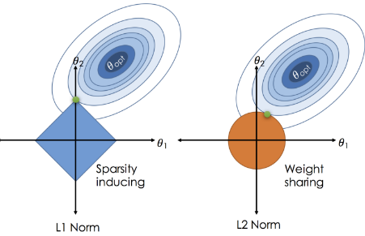
Model Trained
Random Forest &
Extra trees
Regressor
GBR
&
XG-Boost Regressor
K Neighbours Regressor
Support Vector Regressor
Lasso and Ridge regression

Slide 21
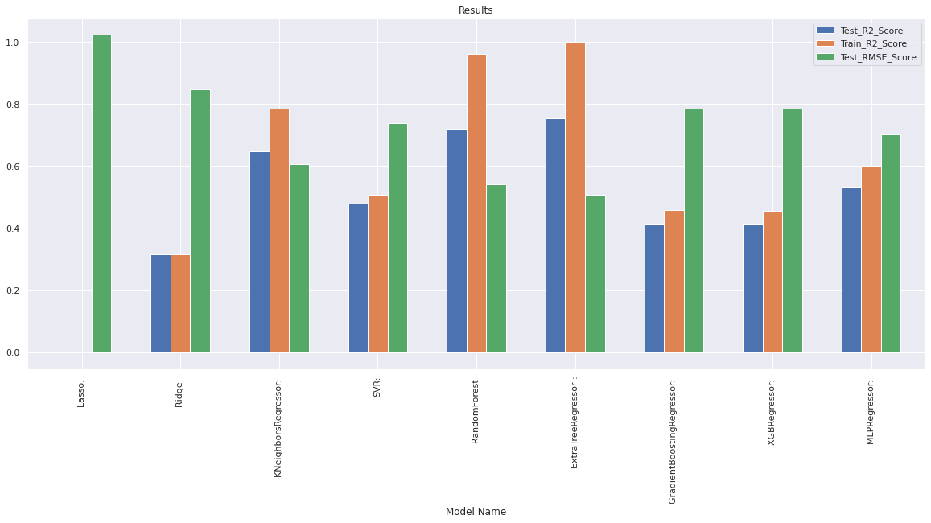
Performance Check (With PCA Features)
Fig: Performance Check

Slide 22
Performance Check (Without PCA Features)
Fig: Performance Check

Slide 23
Best Performing Model
Both features set with or without PCA features perform equally well on our selected tree-based model.
Although Extra trees regressor overfits our training data with an R2 score of 1, it also gives, by far, the best performance on the test set as well compared to other models, with an R2 score of 0.7584.
The test RMSE is also comparatively too low compared to other models.
Hyperparameter tuning of our model doesn’t have any significant impact on our test results. We were able to improve the test R2 score results by less than 1%.
01
02
03
04

Slide 24
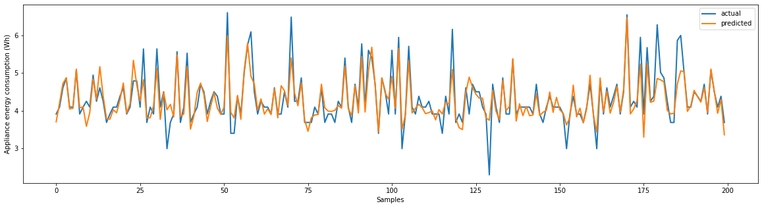
Analysis of our model
Fig: Model Analysis

Slide 25
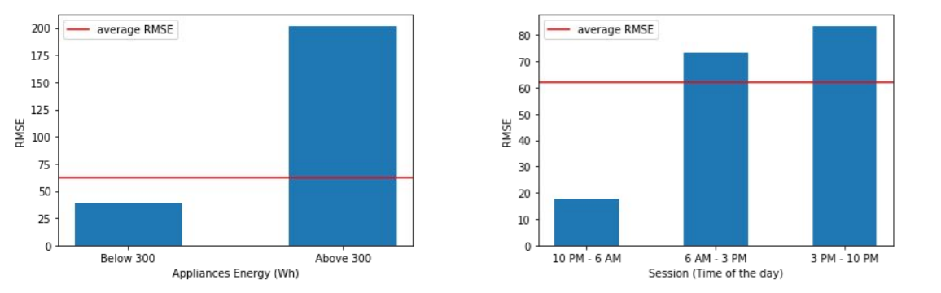
Analysis of our model
Fig: Model Analysis

Slide 26
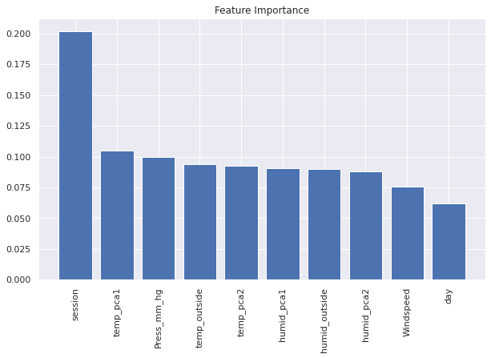
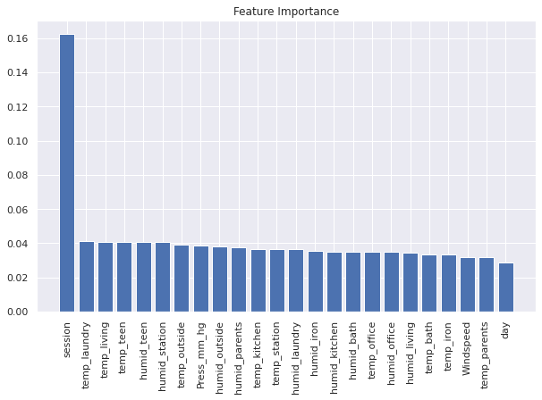
Feature Importance
Feature Importance with PCA
Feature Importance without PCA

Slide 27
Conclusion
The humidity and temperature feature has little to no linear correlation with the target variable.
The time zone of the day plays an important role in deciding the power consumption of appliances.
The best Algorithm to use for this dataset is Extra Trees Regressor (tree-based algorithm).
PCA helped us to reduce our feature set dimension considerably without affecting the performance of our models significantly.
The untuned model was able to explain 75.50% of the variance (R2 score = 0.7550) on the test set, while the tuned model was able to explain 75.84% of the variance (R2 score = 0.7584).
The least RMSE score on the test data set is found to be around 0.5 by the Extra trees regressor model, which is considerably good compared to other models.
Tree-based models are by far the best model while dealing with a data set that has most of its features having no linear correlation with the target variable. For similar reasons, linear models such as linear regression, Ridge, and Lasso perform the worst.
01
02
03
04
05
06
07

Slide 28
THANK YOU!

